Slide 1
The Urinary System
By
Dr. Alia Mohammed

Slide 2
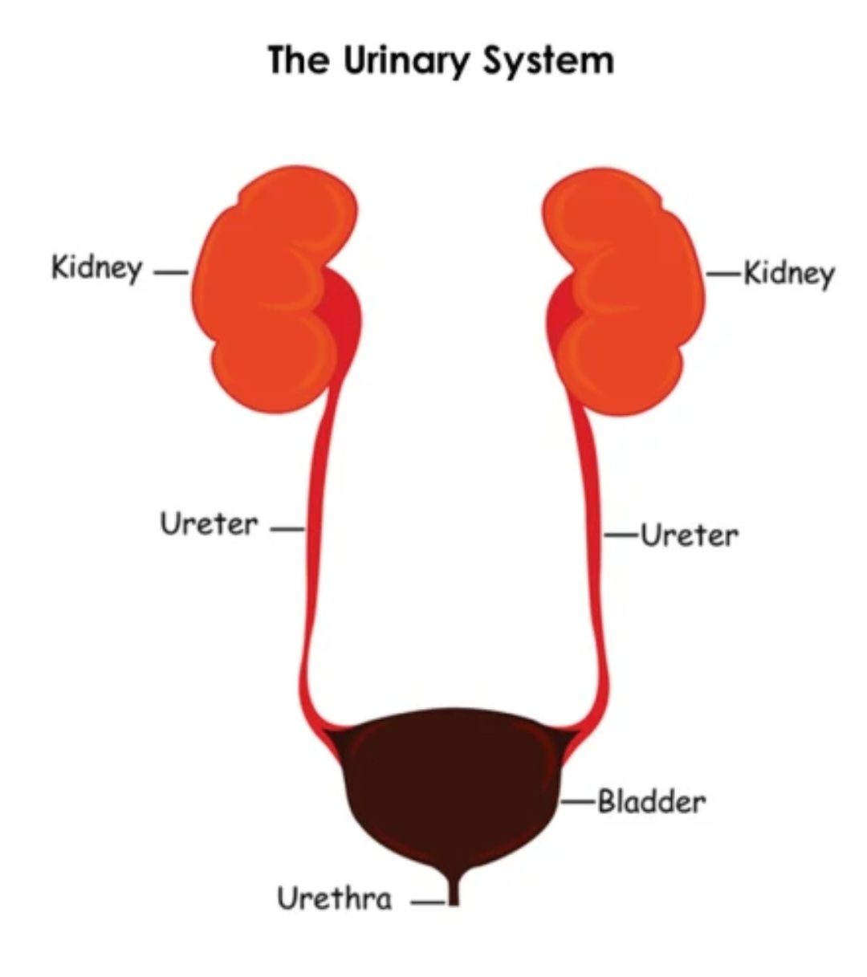
Structure of the urinary system
The urinary system consists of the paired kidneys, ureters, the bladder, and the urethra.
This system’s primary role is to ensure optimal properties of the blood, which the kidneys continuously monitor.

Slide 3
kidneys Function
This general role of the kidneys involves a complex combination of renal functions:
Regulation of the balance between water and electrolytes (inorganic ions) and the acid-base balance.
Excretion of metabolic wastes along with excess water and electrolytes in urine.

Slide 4
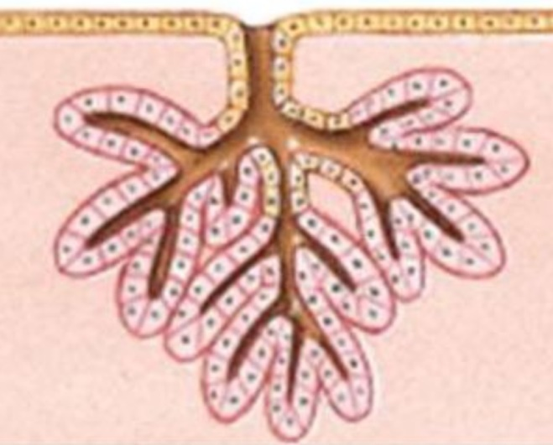
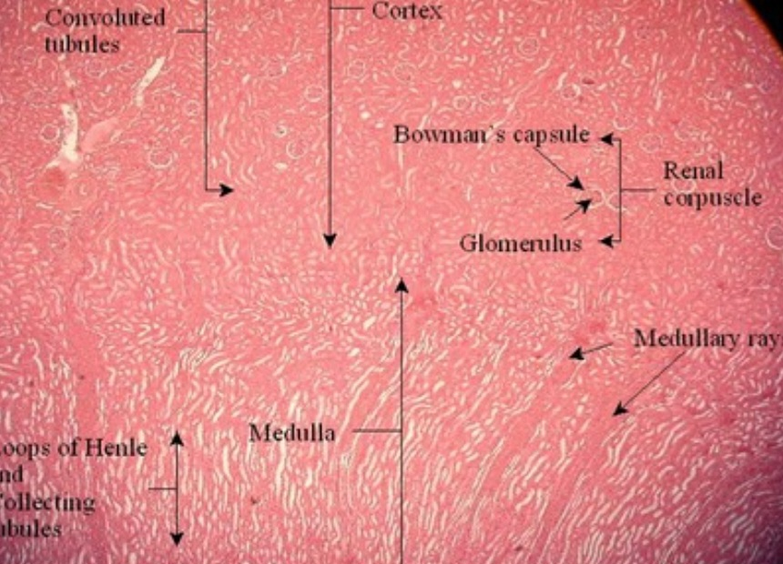
Kidney
The kidney is a compound tubular gland
Formed of 1-4 million urniferous structural unit
The renal tubules are held together by the renal interstitium formed mainly of a network of reticular fibers

Slide 5
kidneys
Size: Approximately 12-cm long, 6-cm wide, and 2.5-cm thick.
Structure: Each kidneys has a concave medial border, the hilum—where nerves enter, the ureter exits, and blood and lymph vessels enter and exit—and a convex lateral surface both covered by a thin fibrous capsule.

Slide 6
Structure of Kidneys

Slide 7
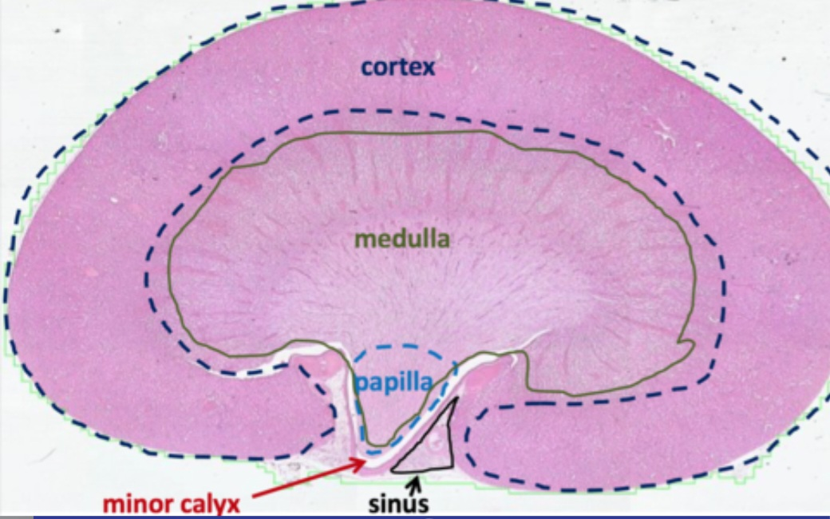
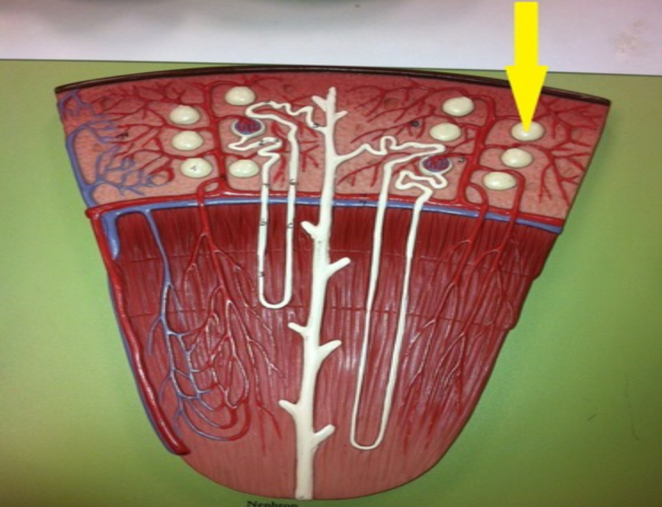
Histological section of the kidney
A- Cortex
It is the dark outer layer.
It has a granular appearance duo to presence of the renal corpuscles and the renal convoluted tubules.
B- Medulla
It is the pale inner layer.
It has a striated appearance duo to the longitudinally arranged straight renal tubules, collecting ducts and the surrounding vessels

Slide 8
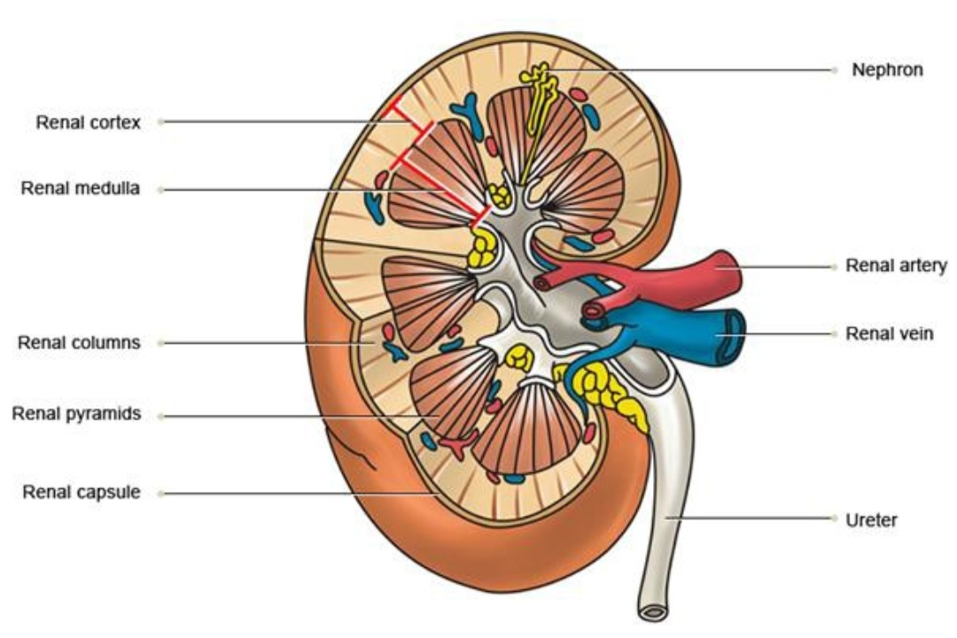
Structure of Corex
Cortex divided into:
Cortex cortices: Under capsule.
Cortex proper: Around medullary rays.
Renal column of Bertini: Between medullary pyramids

Slide 9
Structure of medulla
Medulla consisted of:
Medullary pyramids.
Medullary rays
(collecting tubules).

Slide 10
Terminology
Medullary ray: Striations extend from the medulla into the cortex, represent straight segments of the renal tubules + cortical collecting ducts.

Slide 11
Renal columns: Extension from cortex into the medulla between the medullary pyramids
Renal lobe: Medullary pyramid + mass of cortical tissues surrounding it at the base and sides 1\2 of adjacent renal columns.
Renal lobule: Medullary ray + mass of cotical tissues surrounding it.

Slide 12
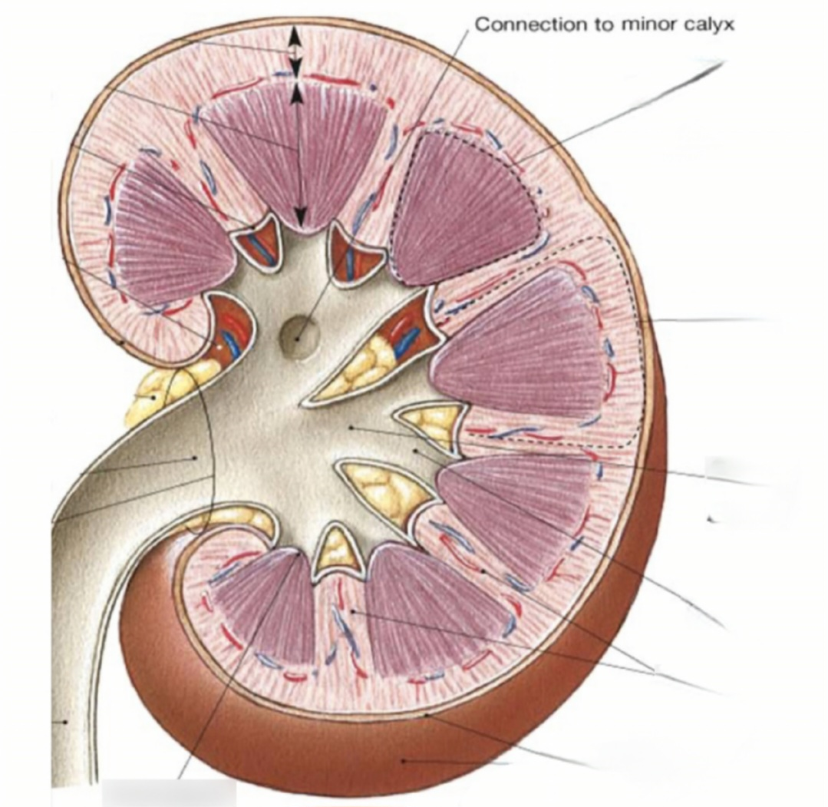

Slide 13
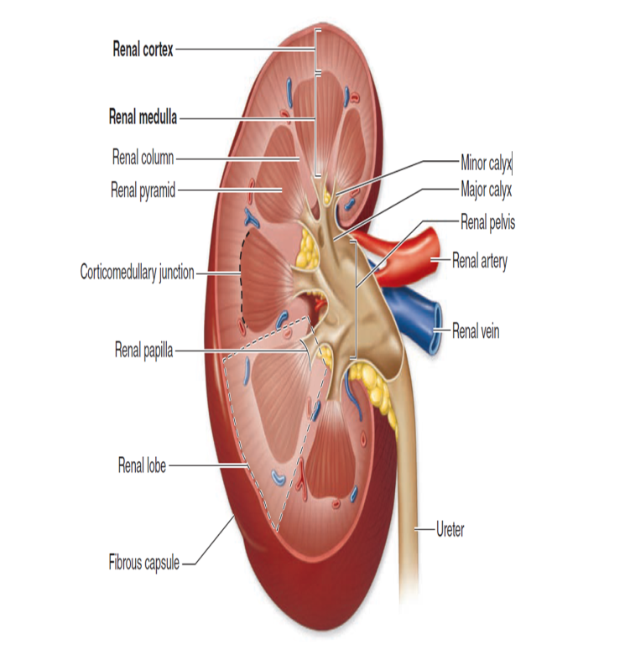
Histological structure of kidney | Cortex | Medulla
1- Appearance | It is the dark layer. It has a granular appearance duo to presence of the renal corpuscles and the convoluted renal tubules. | It is the pale inner layer. It has a striated appearance duo to the longitudinally arranged straight renal tubules, collecting ducts and the surrounding vessels.
2- Contents |  | 8-12 renal pyramids. Their bases: form the cortico medullary junction Their apices (the renal papillae) protrude into the minor calyces The tip of the papilla is performed by the opening of the papillary ducts of Billini and so, it called the area cribrosa

Slide 14
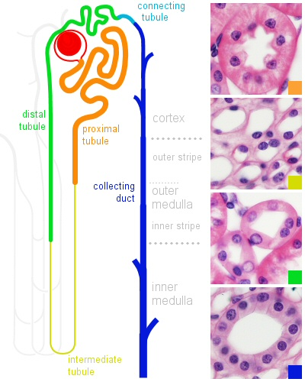
The Uriniferous tubule
It is formed:
The nephron: consists of:
Renal corpuscle.
Proximal convoluted tubule ( PCT).
Loop of Henle.
Distal convoluted tubule (DCT).
Connecting tubule.
B. The collecting duct

Slide 15
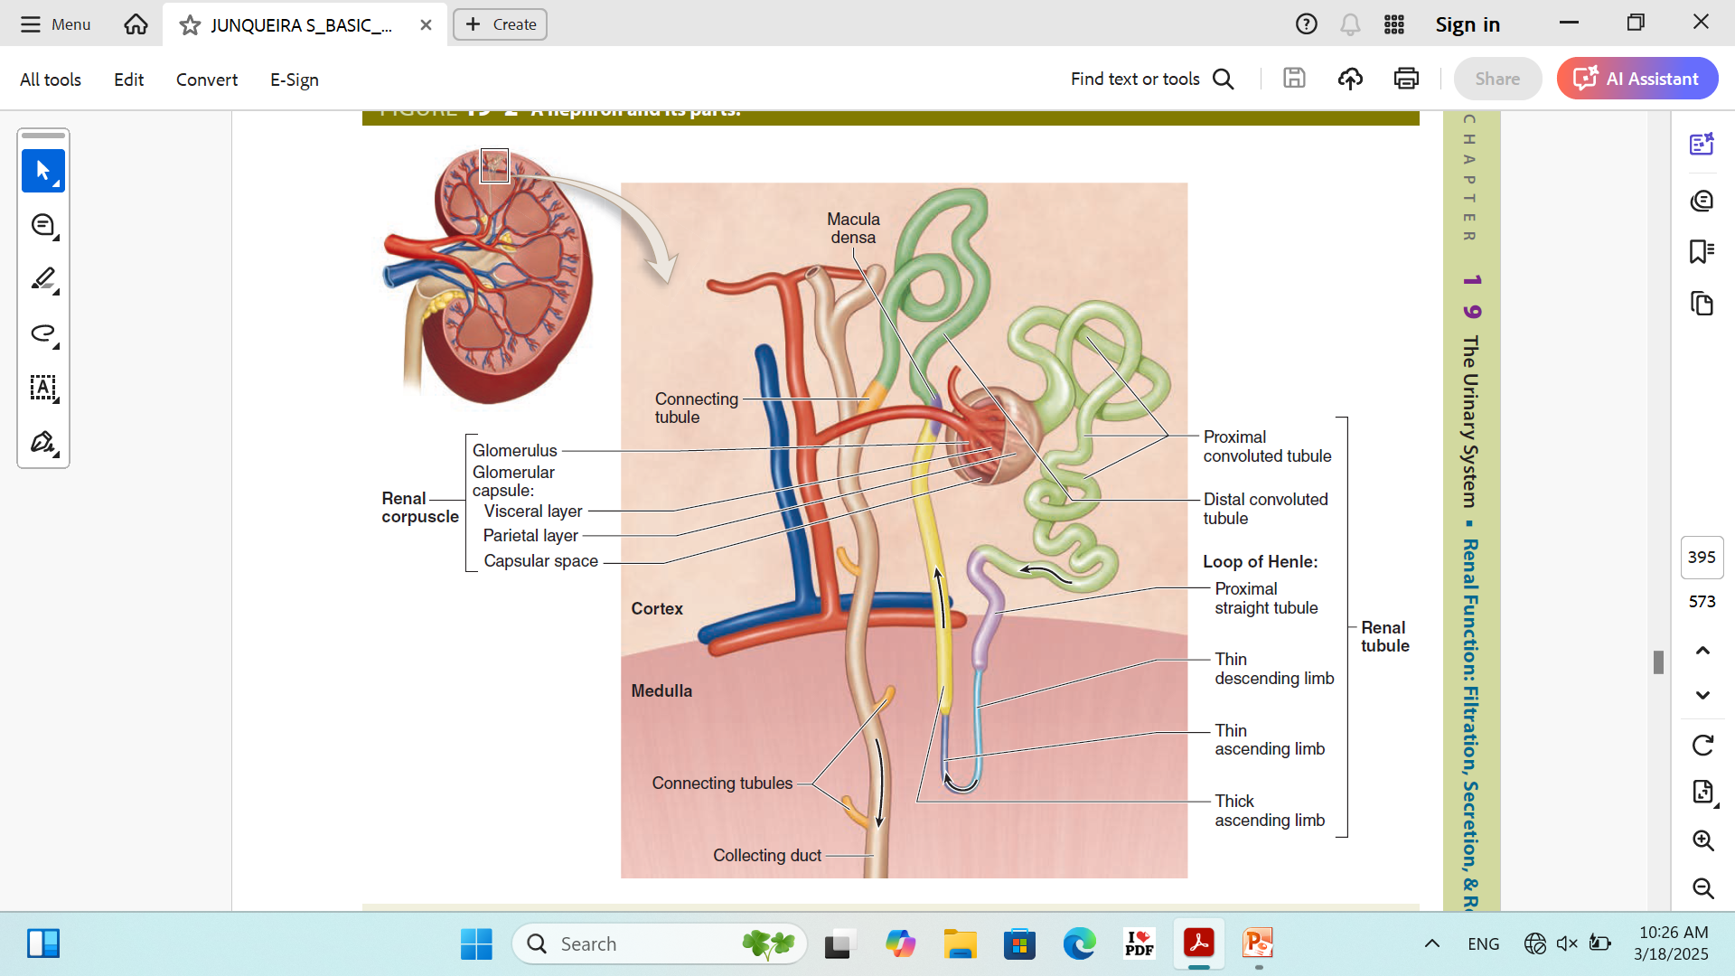

Slide 16
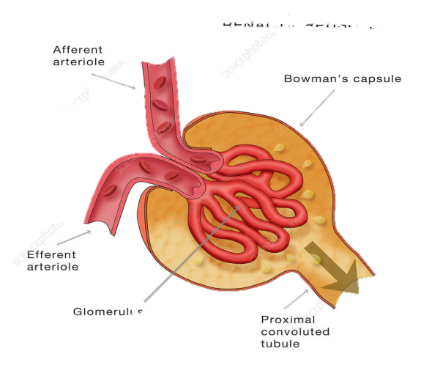
The Nephron
1- The renal corpuscles (Malpigian corpuscle):
It has two poles:
1- Vascular Pole: Where the afferent
Arteriole enters and an efferent
Arteriole leaves the glomerulus.
2- Urinary pole: Where the proximal
Convoluted tubule begins.

Slide 17
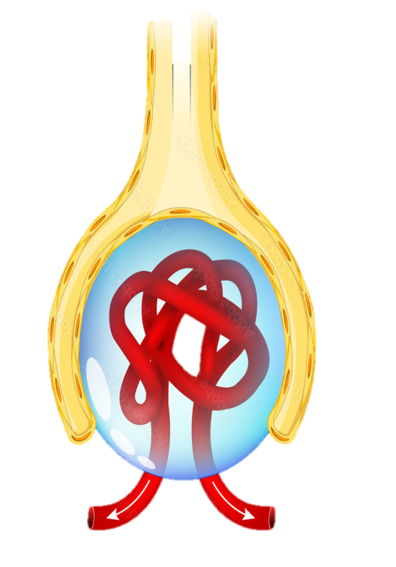
The Nephron
1- The renal corpuscles (Malpigian corpuscle):
A- Bowman's capsule
Has tow layers
1- Outer parietal layer(capsular epith.
Simple squamous epith.
2- Inner visceral layer (glomerular epith): Podocytes

Slide 18
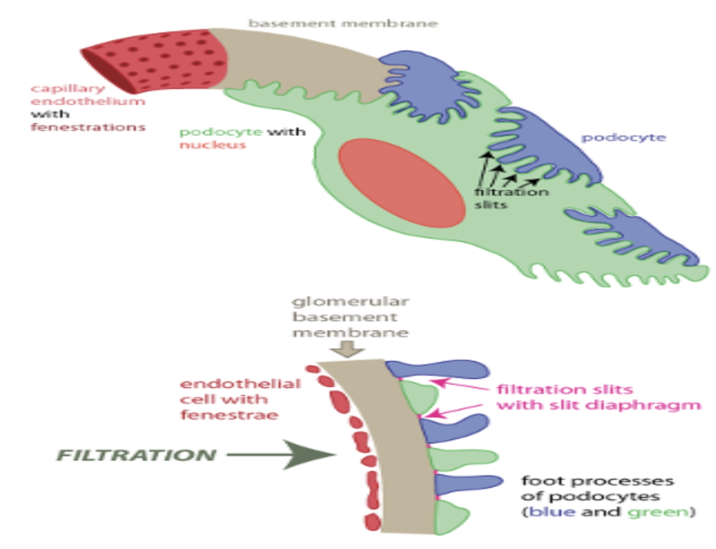
Podocytes
Large flattened modified epithelial cells.
Parts: Major and minor processes with filtration slits
Function: Synthesis of glomerular basement
membrane.

Slide 19
Podocytes

Slide 20
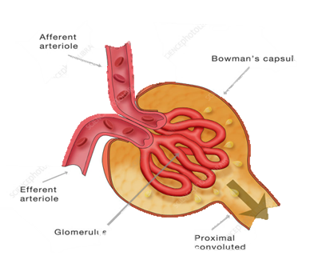
B- The Glomerulus
A tuft of capillary loops.
Arise from afferent arteriole at the vascular pole
(non filtered blood)
Drain into efferent arteriole
(filtered blood).
Lined by fenestrated endothelium
(open)
Has basement membrane

Slide 21
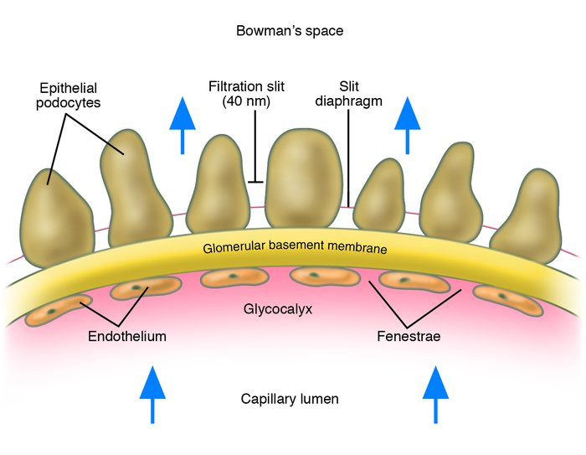
Fenestrated endothelium without diaphragm:
Have very thick basal lamina
Site: Renal glomerular capillaries.
Function of capillaries:
Selective exchange of materials
from blood to tissue.

Slide 22
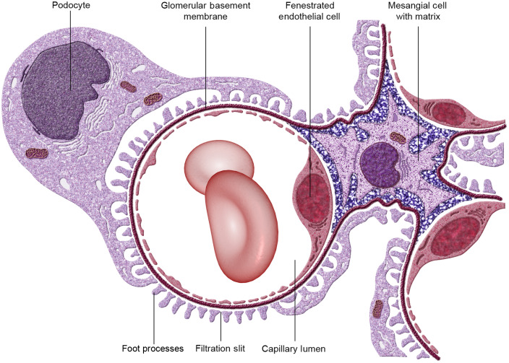
Mesangial cells
Site: Between glomerular capillaries
Stellate shape with basophilic cytoplasm
Function
1- Continuous turnover
of basement membrane
2- Phagocytosis
3- Secret collagen

Slide 23
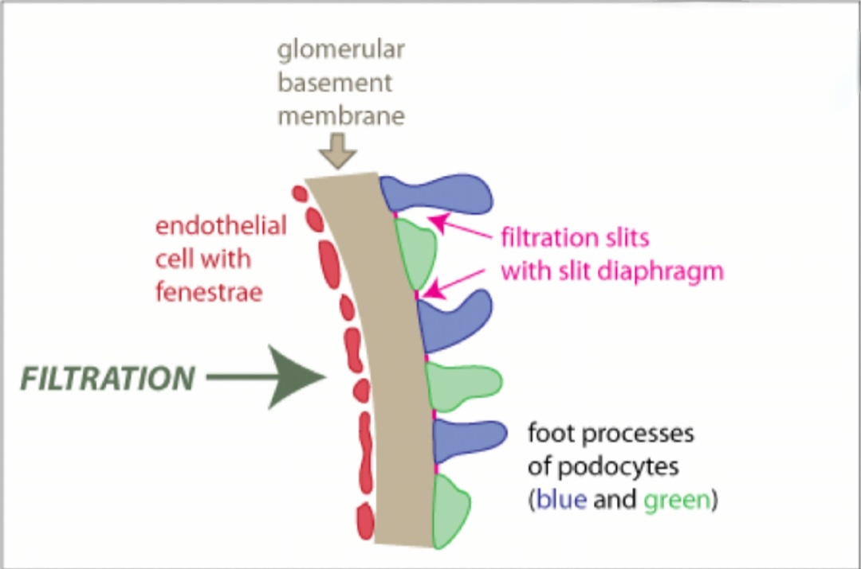
Blood renal barrier Filtration barrier
It separates blood in glomerular capillaries
From capsular space of Bowman's capsule.
Function: blood plasma dialysis.
Parts:
Glomerular endothelium: Holds blood cells.
Basement membrane: Holds plasma protein albumin.
Filtration slit diaphragm: Holds large molecule.

Slide 24
Proximal convoluted tubules (P.C.T.) and Distal convoluted tubules (D.C.T.)
 | P. T. C. | D. C. T.
Function | Reabsorption of water and Na. Reabsorption of glucose, plasma proteins and a. a. Excretion of some metabolites (as dyes) | 1- Reabsorption of water and Na (under control of ADH). 2- Reabsorption of Na (under control of aldosterone H.)
 | 60mu 30-50um
Diameter
Length | 15mm | 5mm

Slide 25
Lining Cells | P. C. T. | D. C. T.
Number | 3-5 cells | 5-8 cells
Shape | Cubical shape | Less cubical
Nucleus | Basal and rounded | Central and rounded
Side border | Not clear | Clear
Luminal border | Microvilli (brush appearance) | Microvilli (few & short)
Base of cell | Basal mitochondrial striation | Basal Mitochondrial striations
Cytoplasm | Deeply acidophilic granular | Pale acidophilic non granular

Slide 26
Proximal convoluted tubules (P.C.T.)

Slide 27
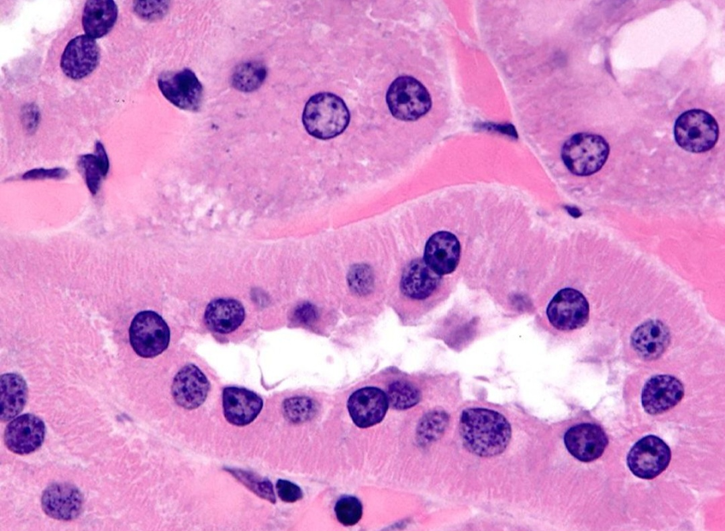
Distal convoluted tubules (D.C.T.)

Slide 28
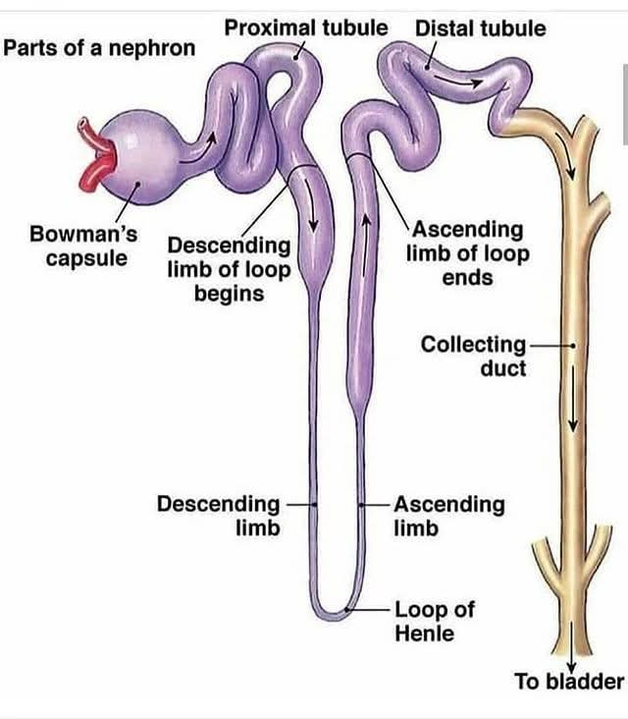
Loop of Henle
U shaped tube connecting P. C. T. & D.C. T.
Descending limb
Ascending limb
Thick part: Simple cubical epith.
Thin part: Simple squamous.
Thin part: Simple squamous.
Thick part: Simple cubical

Slide 29
Function of loop of Henle
Keeping the tissue fluid in the medullary pyramids hypertonic by excretion of NaCl into it, allowing water to pass from C.T. to it thus making urine hypertonic.

Slide 30
Connecting tubules (C. T.)
Short minor part linking the nephron to collecting ducts.
Connecting tubules from several nephrons merge to form collecting tubules.
Collecting ducts:
Larger ducts form according to merge collecting tubules.

Slide 31
Collecting tubules (C. T.)
5-10
Nephrons
6-8
Collecting tubule
Duct of Bellini
Apex of medullary pyramid
In cortex
Cubical with clear basophilic cytoplasm
Columnar cells with clear basophilic cytoplasm

Slide 32
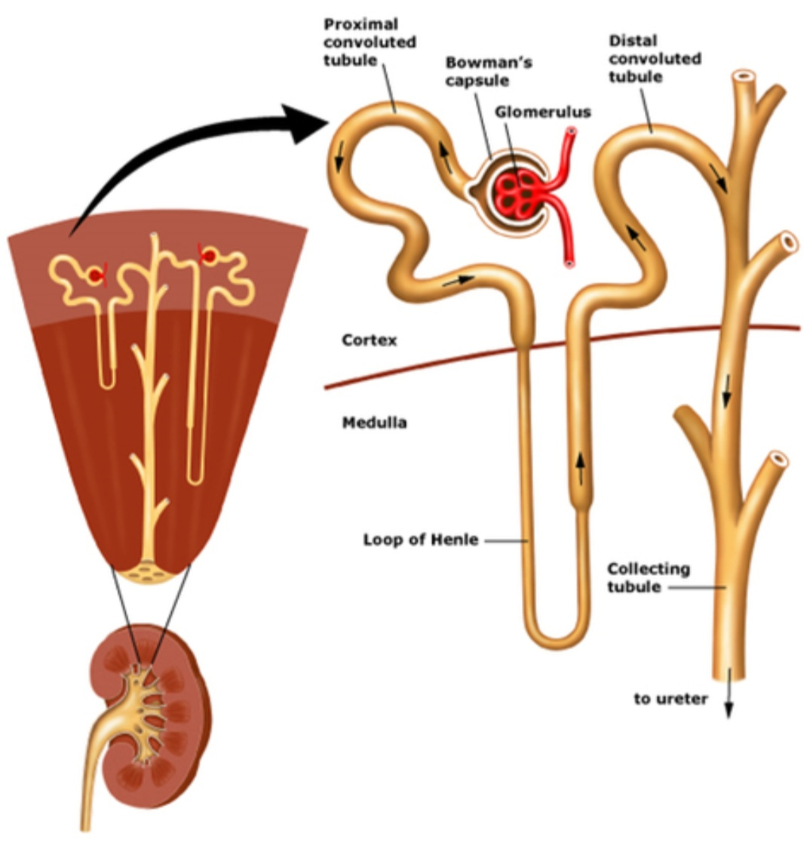

Slide 33
URETERS
Ureters: is a transport organs transports urine from the renal pelvis to the urinary bladder where it is stored until emptying by micturition via the urethra.
The walls of the ureters are similar to that of the calyces and renal pelvis.

Slide 34
URETERS
Mucosa:
Transitional epithelium (urothelium).
The layers:
1- A single layer of small basal cells resting on a very thin basement membrane.
2- An intermediate region containing from one to several layers of cuboidal or low columnar cells.
3- A superficial layer of large bulbous or elliptical umbrella cells, sometimes binucleated.

Slide 35
lamina propria: supports the epithelium, loose connective tissue rich in elastic fibers.
No submucosa
Muscularis externa: consists of smooth muscle arranged in layers, the inner longitudinally and outer circular layers. At the lower third of the ureter, there is an additional outer longitudinal layer.
The bundles of muscle fibers are separated by abundant elastic connective tissue (to allow destination of the wall when filled by urine)
adventitia (or serosa): consists mostly of loose connective tissue with autonomic nerves and plexuses, blood vessels, and lymphatics.

Slide 36
URETERS

Slide 37
HISTOLOGY OF THE URINARY BLADDER
It is formed of three layers:
1- Mucosa:
Shows numerous folds that disappear when the bladder becomes distended (except trigone)
A- The epithelium: Urothelium
Transitional: resting on corrugated basement membrane.
thickness of the epithelium varies according to the degree of distention of the organ. In the contracted (empty) bladder, the urothelium is six to eight cell layers thick, and the most superficial cells are round to pear-shaped.

Slide 38
B- Lamina propria: Loose connective tissue rich in elastic fibers.
2- Muscularis externa:
The detrusor smooth muscle is arranged as inner and outer longitudinal layers and middle circular layer.
The muscle bundles separated by fibro elastic connective tissue to allow bladder distention.
3- Adventitia\ Serosa:
Fibro elastic connective tissue.

Slide 39
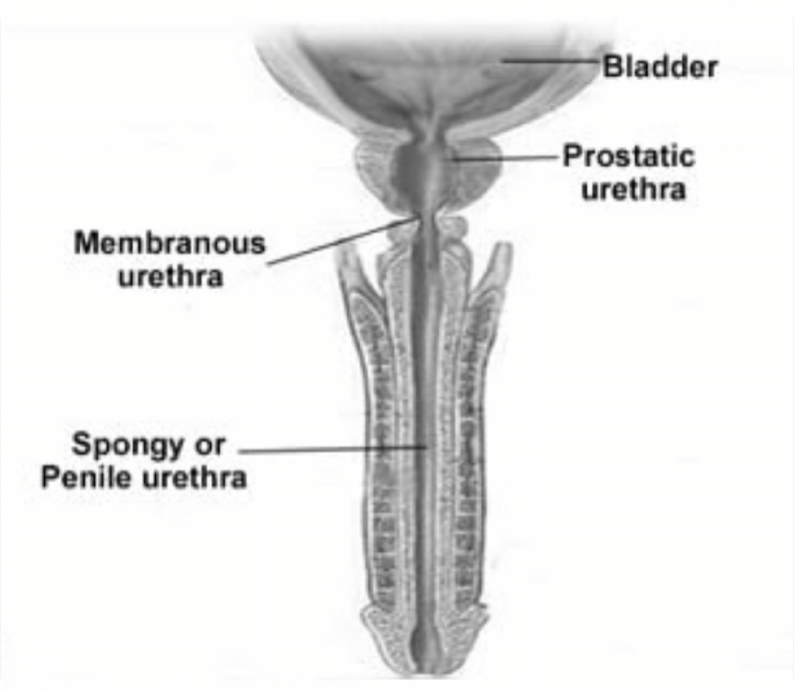
Urethra Male Urethra

Slide 40
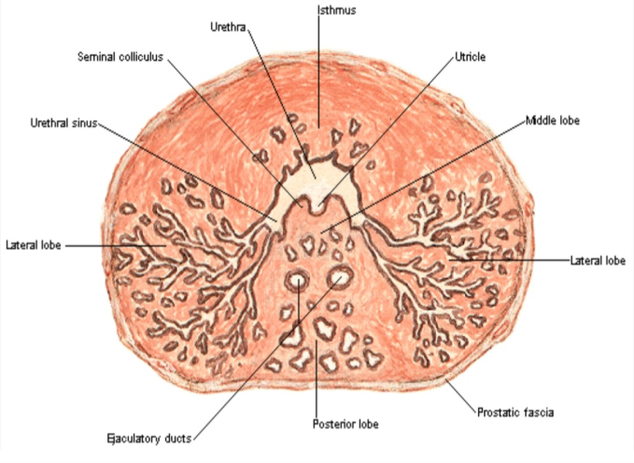
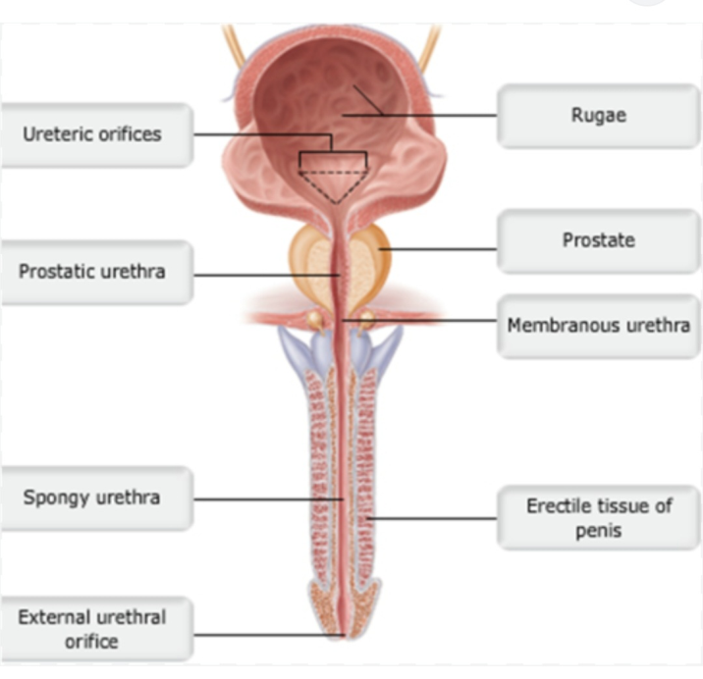
1- Prostatic Urethra
Lined by transitional ep.
Contains opening of (ejaculatory ducts+ ducts of prostatic acini).
2- Membranous Urethra:
Shortest, narrowest and least dilatable part.
Lined by pseudostratified columnar.

Slide 41
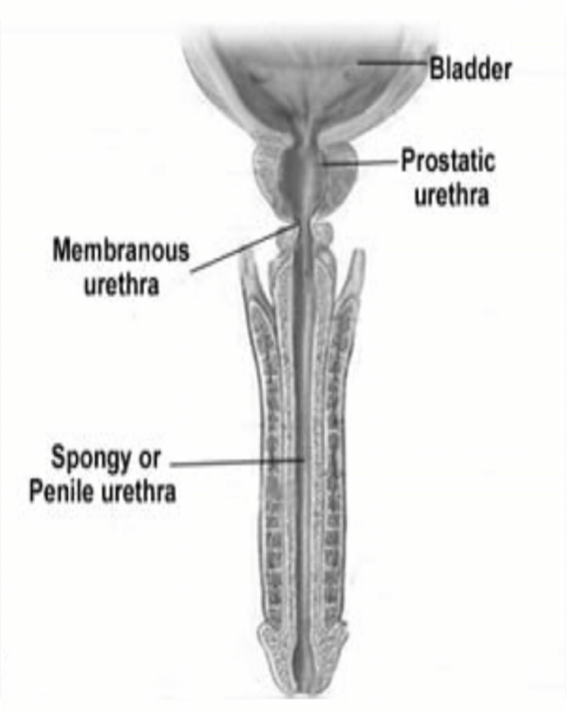
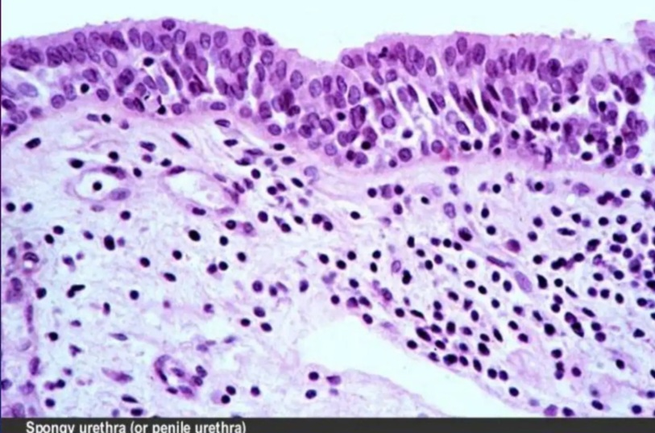
3- Penile urethra
Longest part.
Lined by Pseudostratified columnar epithelium
With areas of stratified columnar.
In the glans, urethra is lined by non- keratinized stratified squamous epithelium.

Slide 42
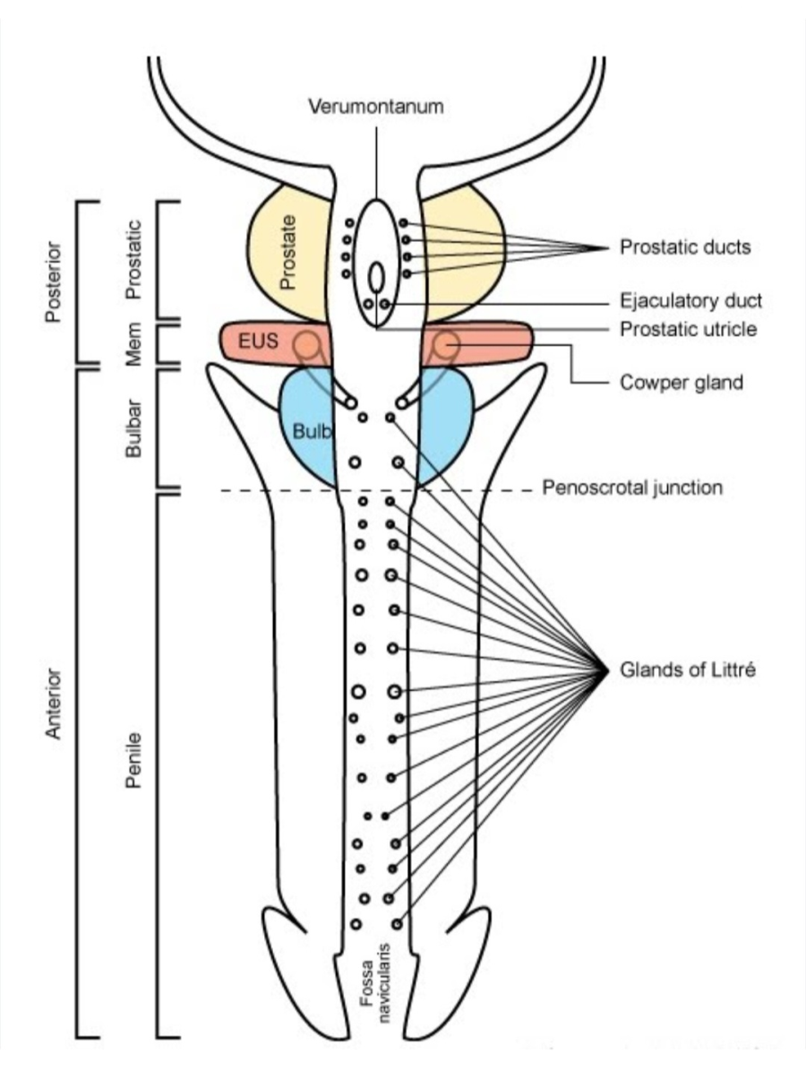
3- Penile urethra
1- Glands of littre and 2- bulbourethral glands.
mucus-secreting

Slide 43
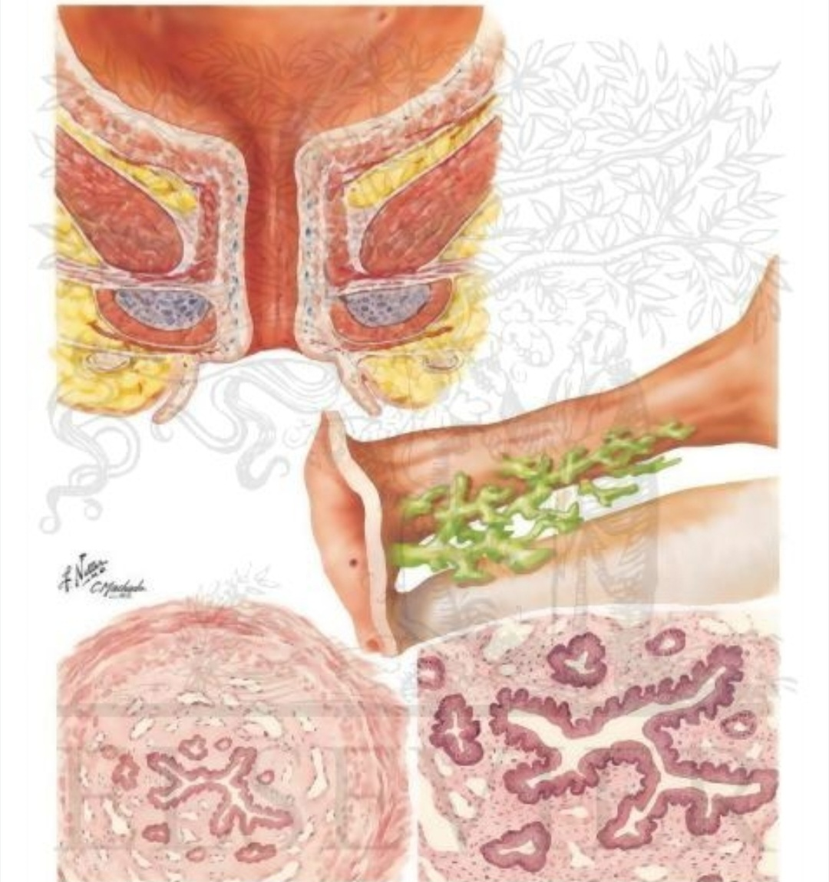
Female Urethra
Lined by
1- Initial part: Transitional.
2- Stratified squamous.
Middle part is surrounded by external urethral sphincter.
Lamina propria: glands of littre.

